Slide 1
KC Real Estate Prediction Modelling
By Nicholus Magak

Slide 2
Project’s Goal
Create a model that can mimic a retailor accurately or make a close guestimate of a house price based on a variety of given predictors.

Slide 3
Data
Floors
Sqft
The number of floors is quite important because it can shift a buyer’s perspective of how attractive a house can be.
The sqft of the house is an important aspect for choosing how to price a house because they dictate the amount of space available for a prospective customer. The Sqft used are: living sqft, lot sqft, above sqft, and basement sqft.
When all these points are placed together, they can give not only dimensions but reasonable factors to differentiate house prices.
Coordinates
Geographical location can be favorable for some e.g., coordinates in the tropics
Contents
Title
Years built and renovated
These can be useful in knowing the different type of houses that preferred over others, whether recently built or timely and old.
Condition and Grade
Both these points come in key in deciding a house price, irrespective of most of the prior data points. It is important to know the types of conditions in a house that can raise or lower sale expectations.

Slide 4
Methods
This sections explores the methods used in getting to our desired goal.
In order to get our goals, we had to:
01
Data Cleaning
02
Dealing with Categorical data
Removing any unnecessary data and changing data formats to match our needed utility.
We ensure that discrete data is labelled properly to avoid poor data representation to the model.
03
Checking for Multicollinearity
04
Transforming non-normal features
We get to check which columns have high correlation in comparison to other columns and the work to reduce that in order to avoid over reliance on one or a few variables.
We make sure that the continuous data that is not normal is the transformed and scaled in order to avoid extremely skewed data.

Slide 5
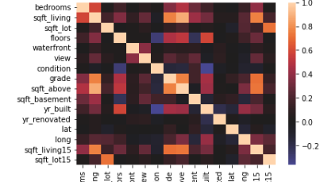

Slide 6
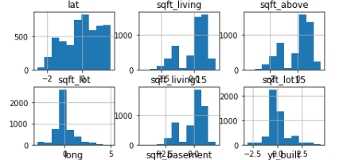

Slide 7
Results
When the methods come together and are modelled to linear regression and decision regression, the following is the result:
Linear Regression
Decision Tree Regressor
The Accuracy of the train model is 58 % while the test model is 59 %
The accuracy of the train model is 99% while the test model is 66%.
Evaluation
Evaluation
The Linear Regression model is being too specific on the test split hence overfitting. The low accuracy is due to poor data preparation which can be redone to improve the overall fit.
This is the better model to use due to both higher accuracy. This will predict the house prices more accurately but given time the accuracy can be improved based on better data preparation.

